Slide 1
Mars as an Exoplanet of an M Dwarf Star
How does the stellar wind of an M dwarf star affect the atmospheric escape of a Mars-like planet?
Xinrun Du
July 29, 2021

Slide 2
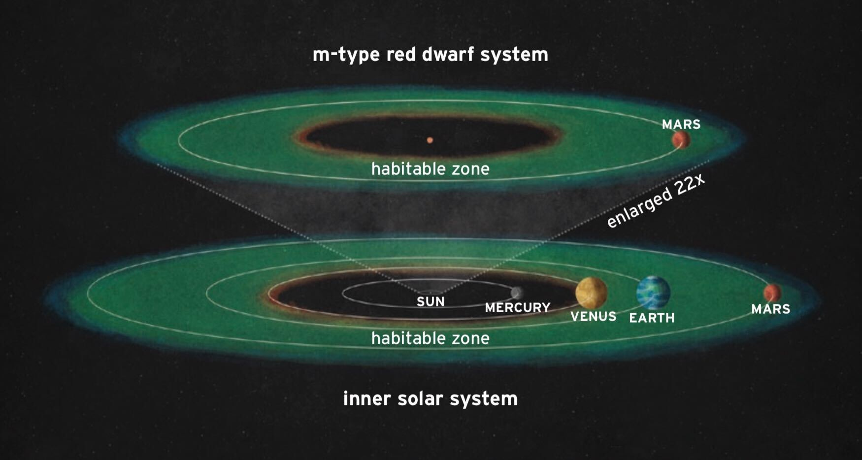
Background
M dwarf stars
By far the most abundant type of stars in our galaxy (~70%).
Star classification: M spectral type
Much smaller & cooler than the Sun---long life span
Habitable zone: 0.03-0.3 AU
Much closer to the host star
Habitable planets are more exposed to the stellar wind.

Slide 3
Background
Mars
Choice of potentially habitable planet due to similarity to Earth in the past
Complex magnetization
Atmospheric loss overtime has been studied a lot

Slide 4
Method
Computer simulations
Input stellar wind parameters from previous works
Stellar wind density, velocity, and IMF
EUV conditions
Distance to the chosen exoplanet
BATS-R-US (developed by University of Michigan)
Solves variables from the equations included in MFPe model
MFPe Multi-fluid Model (Ma et. al 2019)
- Improvement on multi-fluid MHD (magnetohydrodynamics) model
- Additional electron pressure equation

Slide 5
Results

Slide 6
Results
1.
2.
3.
4.
5.
6.

Slide 8
The stellar wind conditions at a specific location—
How ion escape varies with distance from the star

Slide 9
Log L_EUV = (29.12 +- 0.11) – (1.24+-0.15) log [tau]
Tau = age of the star in Gyr

Slide 10
TOI-700 & Trappist-1
Different types of M dwarfs (M2 & M8V)
Relatively accurate stellar wind information

Slide 11
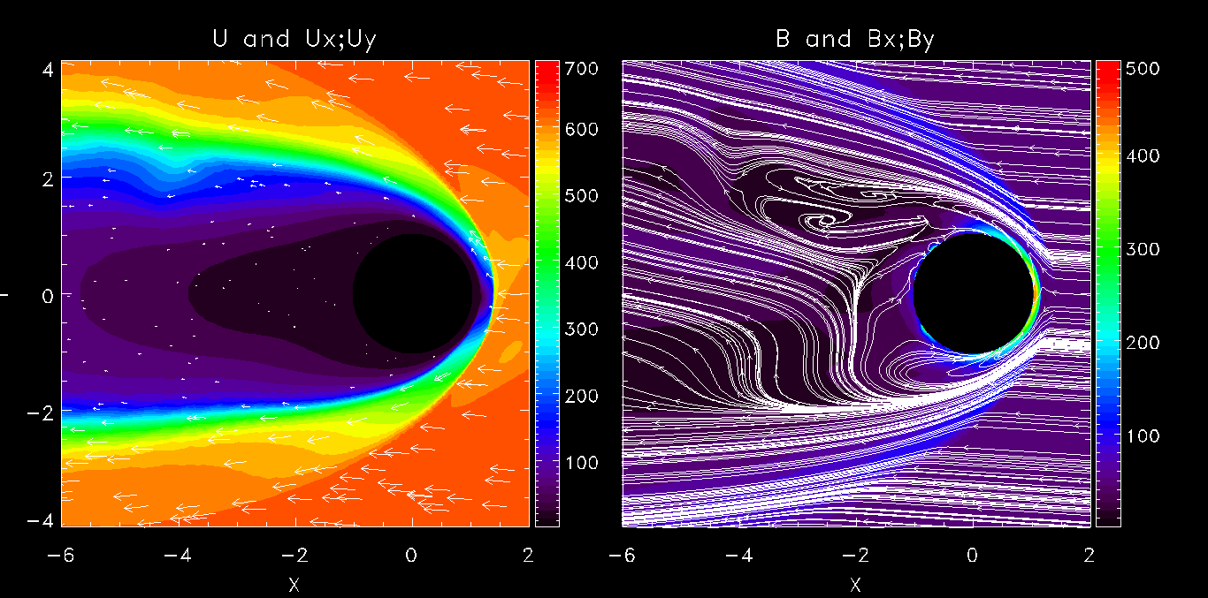
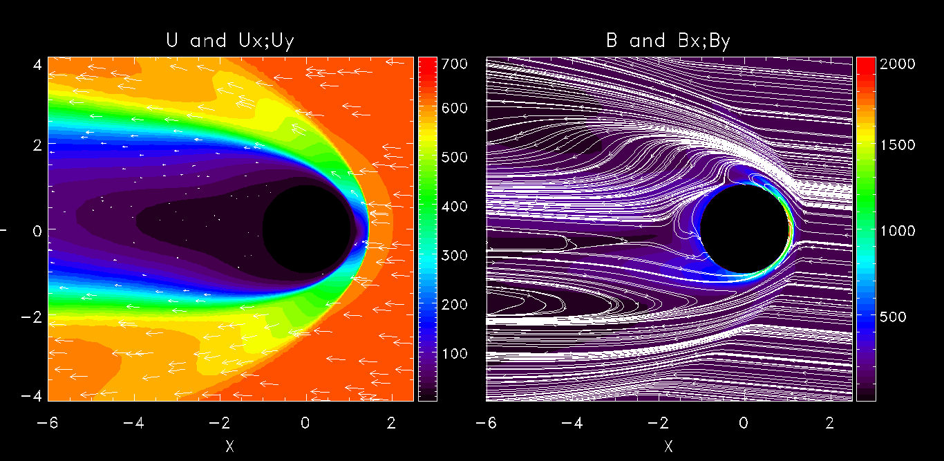
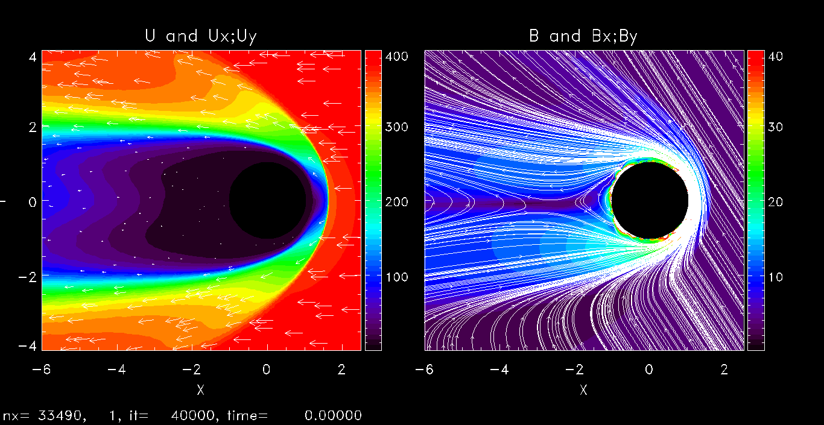
U and Ux;Uy
B and Bx;By
TOI-700
Wind Density (cm^-3) | Wind Velocity (km/s) | IMF (nT)
96.8 | (-650.4, 47.4, -7.4) | (-46.7, 2.9, -3.7)
Trappist-1
Wind Density (cm^-3) | Wind Velocity (km/s) | IMF (nT)
1950 | (-636.7, 40, 2) | (-68.6, 6.2, -28)
Sun (Ma et. al 2019)
Wind Density (cm^-3) | Wind Velocity (km/s) | IMF (nT)
4 | (-400, 0, 0) | (-1.6, 2.5, 0)

Slide 12
TOI-700
Wind Density (cm^-3) | Wind Velocity (km/s) | IMF (nT)
96.8 | (-650.4,47.4,-7.4) | (-46.7,2.9,-3.7)
U and Ux;Uy
B and Bx;By
Y

Slide 13
Trappist-1
Wind Density (cm^-3) | Wind Velocity (km/s) | IMF (nT)
1950 | (-636.7,40,2) | (-68.6,6.2,-28)
U and Ux;Uy
B and Bx;By
Y

Slide 14
Sun (Ma et. al 2019)
Wind Density (cm^-3) | Wind Velocity (km/s) | IMF (nT)
4 | (-400, 0, 0) | (-1.6, 2.5, 0.0)
U and Ux;Uy
B and Bx;By
Y

Slide 15
Rho_p (planetary ion density)= [O2pRho]+[OpRho]+[CO2pRho]
Flux = Rho_p* [Ux]
Log10 (Rho_p)
TOI-700
Wind Density (cm^-3) | Wind Velocity (km/s) | IMF (nT)
96.8 | (-650.4, 47.4, -7.4) | (-46.7, 2.9, -3.7)
Trappist-1
Wind Density (cm^-3) | Wind Velocity (km/s) | IMF (nT)
1950 | (-636.7, 40, 2) | (-68.6, 6.2, -28)

Slide 16
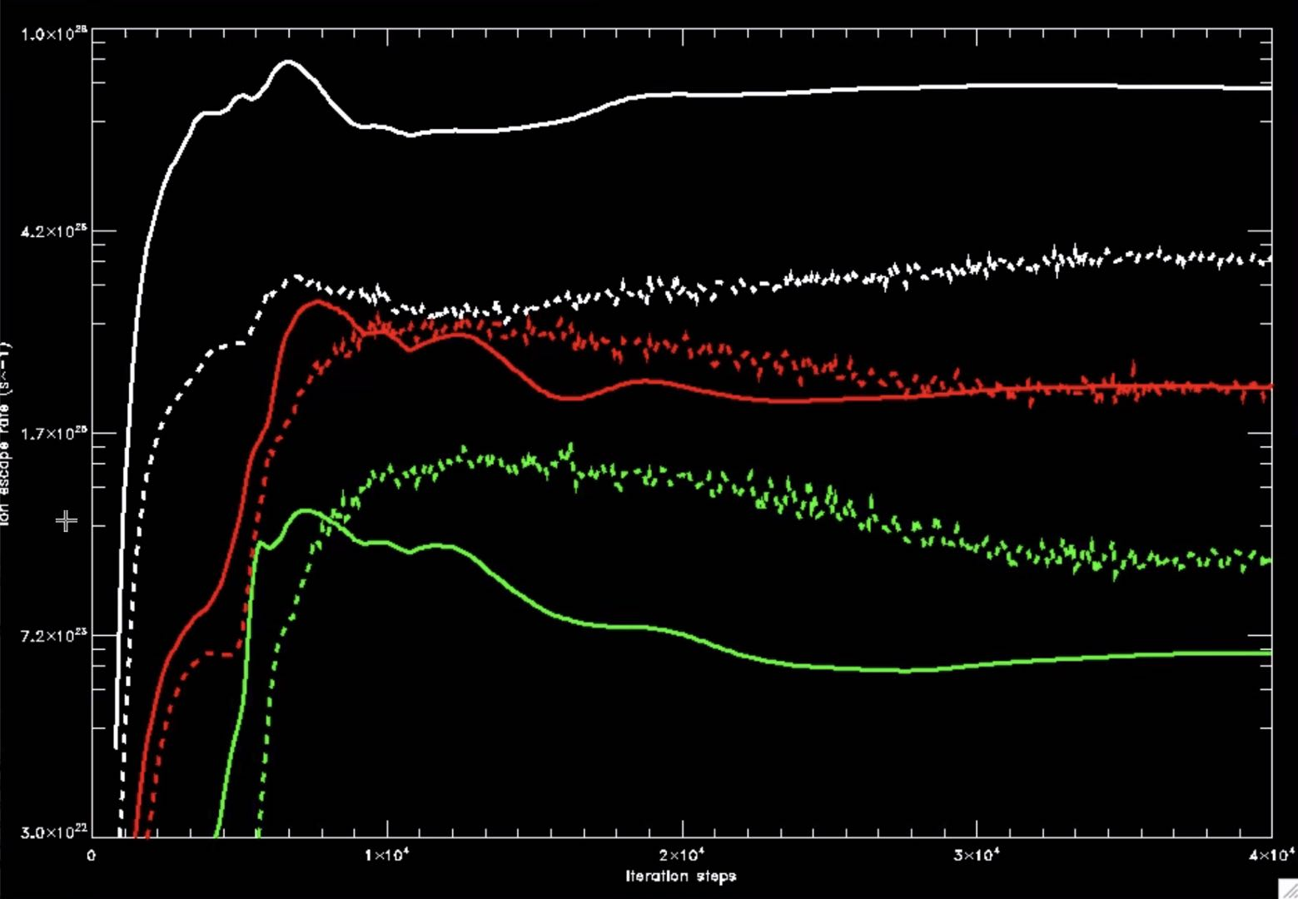
O⁺
- - - TOI-700
—— Trappist-1
Ion escape rate (s^-1)
O₂⁺
CO₂⁺
Iteration steps

Slide 17
Analysis
Preliminary results, further analysis is needed.
Future works
Cases so far use current Mars EUV conditions, continue working on determining proper photoionization rates.
More cases for other M dwarfs will be explored.

Slide 18
Acknowledgement
MACH Center
Dr. Yingjuan Ma
Dr. Laura Peticolas
Boulder Solar REU

Slide 19
Thank you!

